Slide 1
Transfer4D: A framework for frugal motion capture and deformation transfer
1
2
1
,2
Shubh Maheshwari , Rahul Narain , Ramya Hebbalaguppe
TCS Research, India Indian Institute of Technology Delhi, India
1
2
Notes:
Hi, my name is Shubh Maheshwari. I am a researcher at TCS innovation labs and will present our paper, Transfer4D: A framework for frugal motion capture and deformation transfer. This is a joint work with Prof. Rahul and Ramya from IIT Delhi.

Slide 2
Notes:
Motion capture is the process of animating a virtual character based on an actor's real performance.

Slide 3
Low-Cost Motion Capturing System-HuCE cvprLab
Large Production Houses:
Expensive
Multiple cameras/sensors
Markers/templates
System Calibration (multi-camera synchronization)
Notes:
This is a challenging task currently requiring expensive motion capture setups and additional effort by expert animators --- rendering it accessible only to large production houses

Slide 4
Low-Cost Motion Capturing System-HuCE cvprLab
OcclusionFusion, CVPR 2020
Ours:
Frugal
Single depth sensor
No Markers/templates
Minimal effort
Large Production Houses:
Expensive
Multiple cameras/sensors
Markers/templates
System Calibration
Notes:
In our work we attempt to democratize animation transfer by replacing these expensive setups with a single view depth sensor

Slide 5
Problem statement
Can we automate animators' effort in tedious and less creative components of animation?
Image Source: Production Pipeline by Andrew Bean
Notes:
And to automate animators' efforts in laborious rigging and motion transfer steps??

Slide 6
Related Works
Require training supervision/custom dataset
Notes:
Unlike previous approaches, our aim is to generalize to a wide variety of characters of dissimilar shapes without the use of parametric body models and supervision.

Slide 7
Related Works
Require training supervision/custom dataset Only transfer human motion
Notes:
our approach is category agnostic and can be used not only on humans but also for animals, birds and other articulated objects.

Slide 8
RESULT OF OUR UNSUPERVISED TECHNIQUE FOR INTRA-CATEGORY MOTION TRANSFER
Notes:
Transfer4D is a generic framework for transferring motion from a single view depth video to user defined target mesh
We aim to democratize content creation by replacing expensive mocap setups with a single depth sensor, and by automatically rigging characters to transfer motion

Slide 9
Overview of Transfer4D

Slide 10
Challenges to Democratization via Frugal sensors
1. Input: A single-view video feed that implies partial information
Could be noisy
Sparse
2. Output:
Deformation of user-defined polygon mesh without a predefined skeletal rig
Why this set-up?
The approach is frugal; it enables mass market reach and is more practical for deployment in future
Notes:
We use a single depth sensor, thus, our input only captures the front-view of the source object and can be noisy.

Slide 11
Challenges to Democratization via Frugal sensors
1. Input: A single-view video feed that implies partial information
Could be noisy
Sparse
2. Output:
Deformation of user-defined polygon mesh without a predefined skeletal rig
Why this set-up?
The approach is frugal; it enables mass market reach and is more practical for deployment in future
Notes:
Furthermore the user-defined mesh might contain a predefined skeleton rig

Slide 12
Challenges to Democratization via Frugal sensors
1. Input: A single-view video feed that implies partial information
Could be noisy
Sparse
2. Output:
Deformation of user-defined polygon mesh without a predefined skeletal rig
Why this set-up?
The approach is frugal; it enables mass market reach and is more practical for deployment in future
Notes:
this makes our approach frugal, enables mass market reach, and is more practical for deployment

Slide 13
Challenges to Democratization via Frugal sensors
Shape matching between sparse source and complete target shape has not been explored extensively in literature for non-humans
Prior works make a stricter assumption on the source to be noise-free and watertight.
Our approach is category agnostic
Notes:
However, 1,2,3

Slide 14
Pipeline

Slide 15
overview
Given the depth video,
(a) Non-rigid registration (NRR):
to align the source object at a canonical frame to every frame,
(b) Skeletonization: uses the geometry and estimated trajectory of the object to extract its underlying skeletal structure and the motion.
(c) Skeleton embedding: the obtained motion skeleton is embedded inside the target mesh and skinning weights are calculated.
(d) Motion retargeting: the rotation of the bones is transferred from the motion skeleton to the target skeleton.

Slide 16
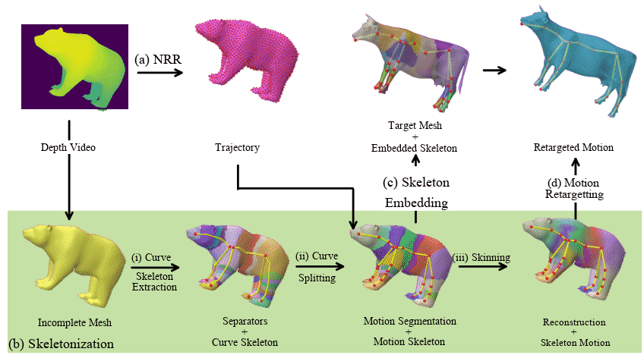
overview
Given the depth video,
(a) Non-rigid registration (NRR):
to align the source object at a canonical frame to every frame,
Notes:
Given a depth video, we perform Non rigid registration to align the source object at a canonical frame to every other frame of the video thereby obtaining its trajectory.

Slide 17
overview
Given the depth video,
(a) Non-rigid registration (NRR):
to align the source object at a canonical frame to every frame,
(b) Skeletonization: uses the geometry and estimated trajectory of the object to extract its underlying skeletal structure and the motion.
Notes:
Then skeletonization uses the geometry and the trajectory to extract the underlying skeletal structure and its the motion

Slide 18
overview
Given the depth video,
(a) Non-rigid registration (NRR):
to align the source object at a canonical frame to every frame,
(b) Skeletonization: uses the geometry and estimated trajectory of the object to extract its underlying skeletal structure and the motion.
(c) Skeleton embedding: the obtained motion skeleton is embedded inside the target mesh and skinning weights are calculated.
Notes:
In the skeleton embedding step, the obtained motion skeleton is embedded inside the target mesh and skinning weights are calculated for deforming the target mesh

Slide 19
overview
Given the depth video,
(a) Non-rigid registration (NRR):
to align the source object at a canonical frame to every frame,
(b) Skeletonization: uses the geometry and estimated trajectory of the object to extract its underlying skeletal structure and the motion.
(c) Skeleton embedding: the obtained motion skeleton is embedded inside the target mesh and skinning weights are calculated.
(d) Motion retargeting: the rotation of the bones is transferred from the motion skeleton to the target skeleton.
Notes:
Finally, for motion retargetting, the rotation of the bones is transferred from the motion skeleton to the embedded skeleton

Slide 20
Proposed Skeletonization procedure
Notes:
To align source object we require a skeletonization method, (a) does not require markers or predefined template, (b) works on single-view incomplete mesh sequence
We propose a novel skeletonization approach that helps in motion transfer by reducing artifacts that arise solely through motion skeletonization.

Slide 21
(i) Curve skeleton:
Notice that the extracted joint position from Local separators lies on the surface of the incomplete mesh. Our optimization aligns the joint position to the medial axis of the object.
1
1
Skeletonization via Local Separators, ACM Transactions on Graphics
Notes:
To achieve this, we construct the motion skeleton using the structural cues of the curve skeleton extracted from Local Separators.
Notice that the extracted joint position from Local separators lies on the surface of the incomplete mesh. Our optimization aligns the joint position to the medial axis of the object.

Slide 22
(i) Curve skeleton:
Notice that the extracted joint position from Local separators lies on the surface of the incomplete mesh. Our optimization aligns the joint position to the medial axis of the object.
1
(ii) Motion Skeleton:
To incorporate the motion information, each curve of the extracted curve skeleton is split into multiple bones
Notes:
To incorporate the motion information, each curve of the extracted curve skeleton is split into multiple bones. More details can be found in the paper.

Slide 23
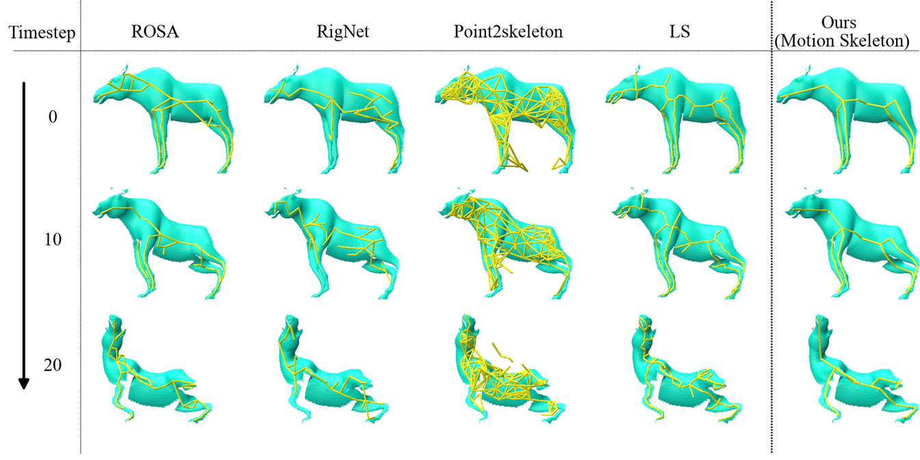
Comparison
Compared to the skeleton extracted from static skeletonization methods, by utilizing motion information, ours method produces temporally coherent skeleton
Notes:
Compared to the skeleton extracted from static skeletonisation methods, by utilizing motion information, ours method produces temporally coherent skeleton

Slide 24
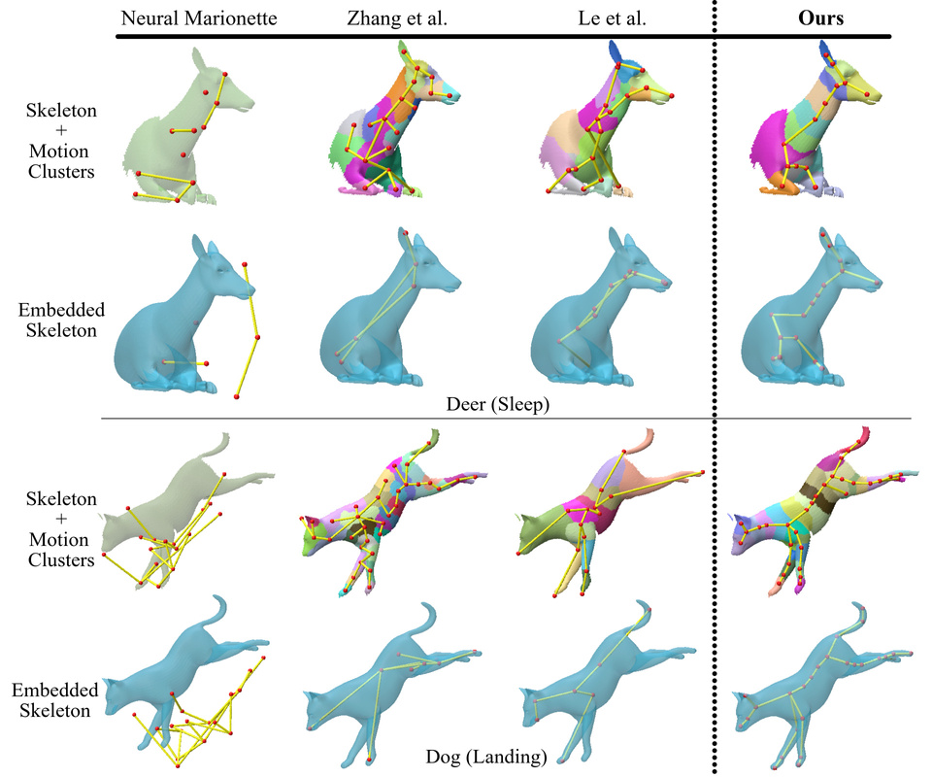
Comparison
Compared to the skeleton extracted from static skeletonization methods, by utilizing motion information, ours method produces temporally coherent skeleton
Compared to other motion skeletonization methods, by incorporating structural cues, ours is more effective at embedding the skeleton from incomplete mesh sequence.
Notes:
Unlike other motion skeletonization methods, by incorporating structural cues, ours is more effective at embedding the skeleton from incomplete mesh sequence.

Slide 25
Results
Notes:
Next we show results from our method,

Slide 26
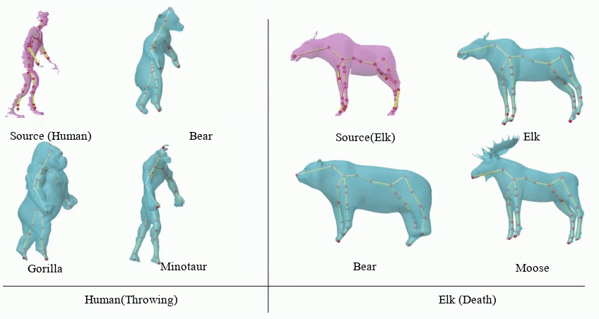
Animation Transfer
Notes:
Motion of the source object is shown in pink and the deformed user mesh in teal

Slide 27
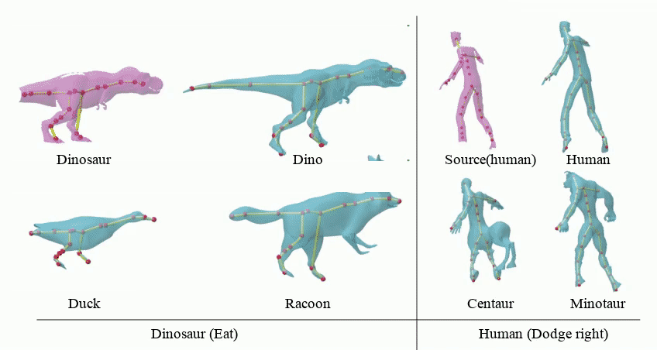
Animation Transfer BIPEDS
Notes:
Here we show the results of motion transfer for bipeds.

Slide 28
Animation Transfer Quadrupeds

Slide 29
Limitations
(1) Unable to capture large deformation between the source and target frame
(2) source and target shapes should be in approximately the same pose
Notes:
Note:-
Our NRR implementation does not perform any volumetric integration during motion capture. Thus, actions with 180-degree rotations like spinning or turning cannot be captures.
2. Our use of Pinocchio leads to a limitation that the source and target shapes should be in approximately the same pose for skeleton embedding to succeed

Slide 30
Conclusion
Transfer4D is a frugal alternative that uses only commodity depth sensors and further reduces animators’ effort by automating the rigging and animation transfer process
Notes:
We presented Transfer4D, a pipeline in the direction of unsupervised animation transfer from single-view commodity sensors to virtual characters
We propose a novel skeletonization approach that helps in motion transfer reducing artifacts that arise solely through motion skeletonization.
We also highlight challenges faced and a few limitations of our and the existing approaches to be more effective for the democratization of animation transfer:
Handling noisy data
Pose
Large topological variations between source and target shapes.
4. More details can be found on our project page. Scan the QR Code for more details.

